Slide 1
Digital Logic Design
CSE 131Digital Logic Design
Dr. Gamal Fahmy
K Maps
© Gamal Fahmy

Slide 2
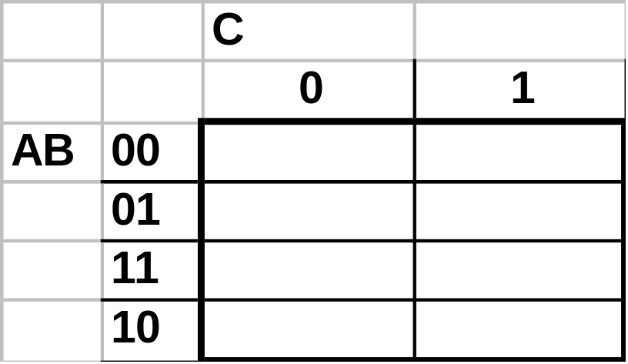
  Defn: Implicant - Any selected Boolean cube with the same value on all vertices.
  Defn: Prime Implicant - Any implicant that cannot be completely enclosed by another implicant.
0
*
1
*
1
0
*
*
1
1
0
1
  Essential Prime Implicants: Prime Implicants (PI) covering a square covered by no other PI.

Slide 3
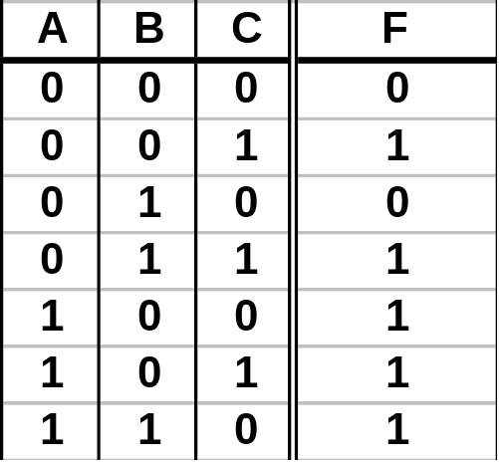
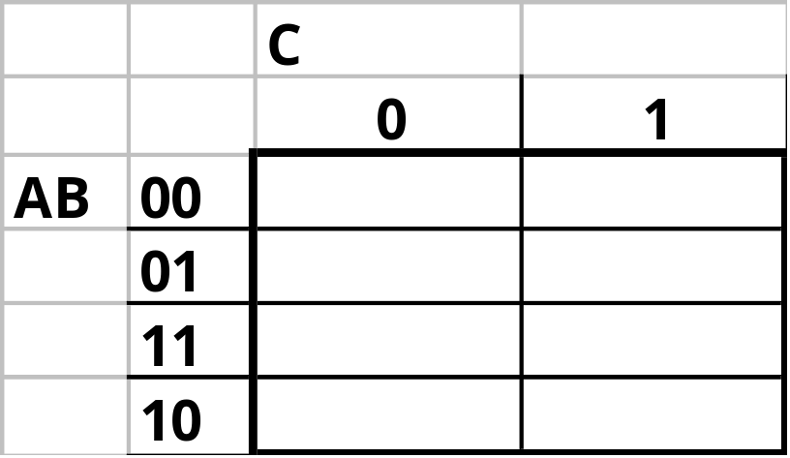

EX: Find the Min SOP for the following 3-variable function:
0
1
0
1
1
1
1
1
  Construct the Karnaugh Map
  Fill in the K-Map
F=A
+C
  Identify the adjacency groupings

Slide 4
Using Karnaugh Maps to minimize functions by grouping 1’s gave a Min SOP Form:
Using Karnaugh Maps to minimize functions by grouping 0’s gives a Min POS Form:

Slide 5
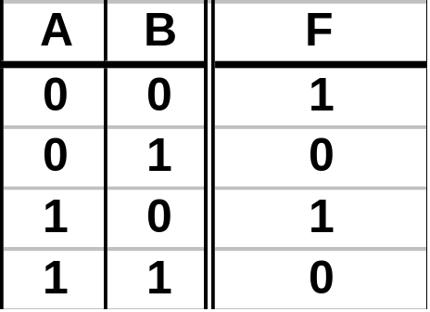
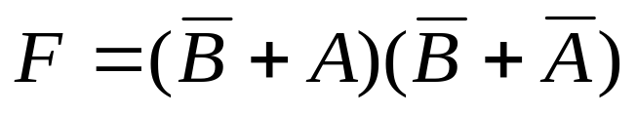
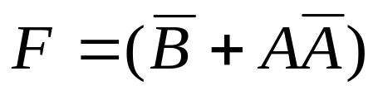
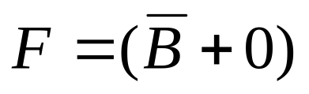

The dual of the Uniting theorem is the basis upon which POS is derived from K-Maps. Starting with a Canonical POS form.
Distr.
Compl.
Ident.
Eliminate the varying variable.
Write Canonical POS form using remaining variables.

Slide 6
Following the dual of the development for SOP we could show that the Karnaugh Map Method is valid for POS forms.

Slide 7
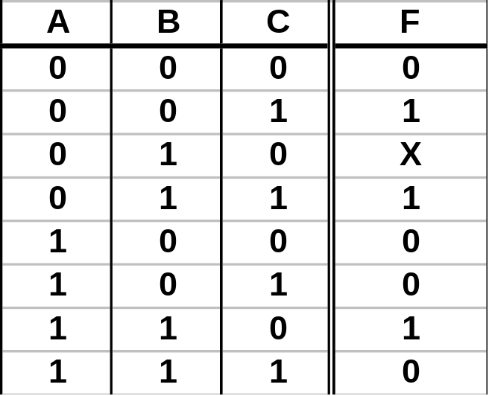
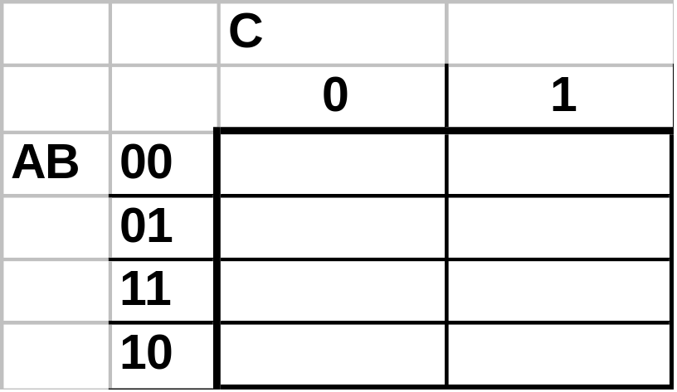
EX: Find the Min POS for the following 3-variable function:
0
1
X
1
1
*
0
0
0
F=(C+B)
(A+C)
  Identify all Prime Implicants
  Identify Essential Prime Implicants

Slide 8
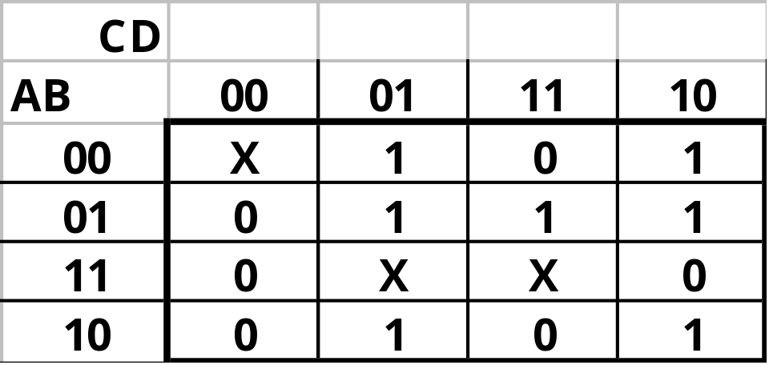
TEAMS: Find the Min POS for the following 4-variable function:
First find all PI’s then identify all EPI’s.

Slide 9
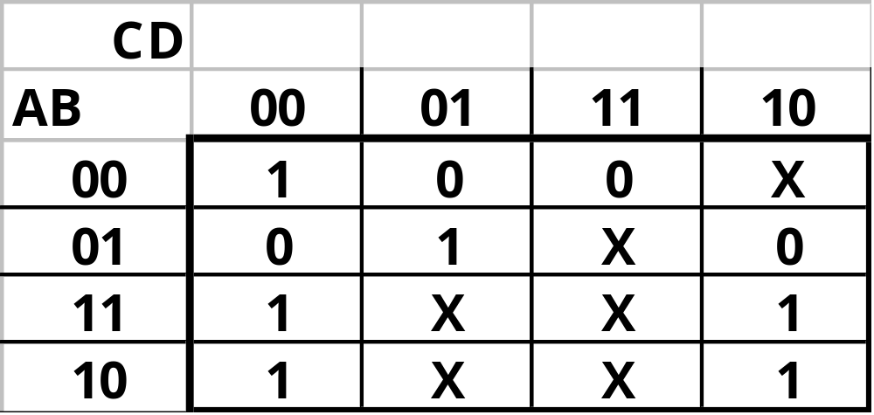
TEAMS: Find the Min POS for the following 4-variable function:

